Slide 1


JAVA PROJECT
Supervised by P. BOSSOU

Slide 2
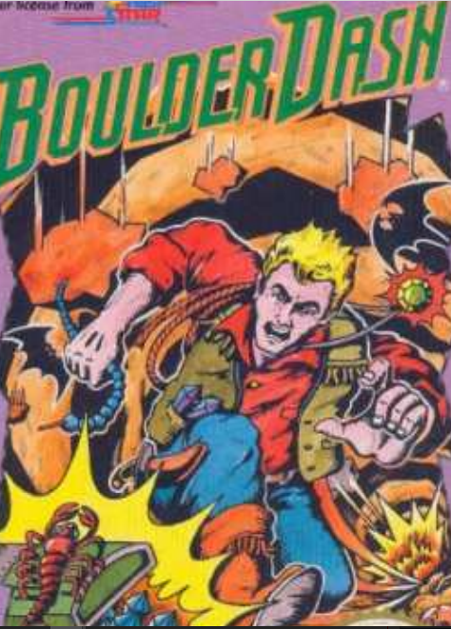
SUMMARY
PRESENTATION OF THE PROJECT
WORK ORGANIZATION
MVC ARCHITECTURE
DATABASE
ILLUSTRATION
6
CONCLUSION

Slide 3
I. PRESENTATION OF THE PROJECT
INTRODUCTION
Boulder Dash is an abandonware created in 1984 by Peter Liepa and Chris Gray. After our study on object-oriented programming, our project consisted in the reproduction of this game.

Slide 4
NEEDS
CONTEXT
- Reproduce the mechanics of the game (collision, scenery, movements ...)
- Realization of 5 accessible levels in the code.
- The different levels must be stored in a database.
C
N
Our project was to reproduce an abandonware called boulder dash. However, we had certain constraints to respect.
C
P
PROBLEMATIC
CONSTRAINTS
How to reproduce our abandonware name boulder while respecting its obligations 5 levels, collision without forgetting the relationship with the database
- Mandatory use of Java, Git, JUnit
- Using java Swing
SQL queries will have to be done by procedures set up in the database
Presentation in English

Slide 5
II. WORK ORGANIZATION
FORECAST DIAGRAM
REAL DIAGRAM

Slide 6
FORECAST DIAGRAM

Slide 7
REAL DIAGRAM

Slide 8
III. MVC ARCHITECTURE
Model
VIEW
Controller

Slide 11
IV.DATABASE

Slide 12

V.
ILLUSTRATION

Slide 13

VI. CONCLUSION
Thank you for your kind attention

